Slide 1
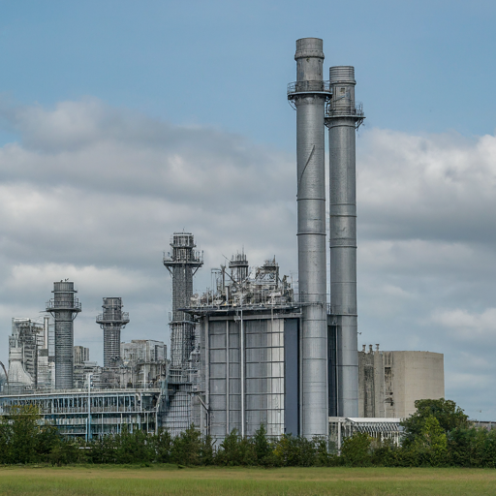
Combined Cycle Power Plant Performance
By Group 1

Slide 2
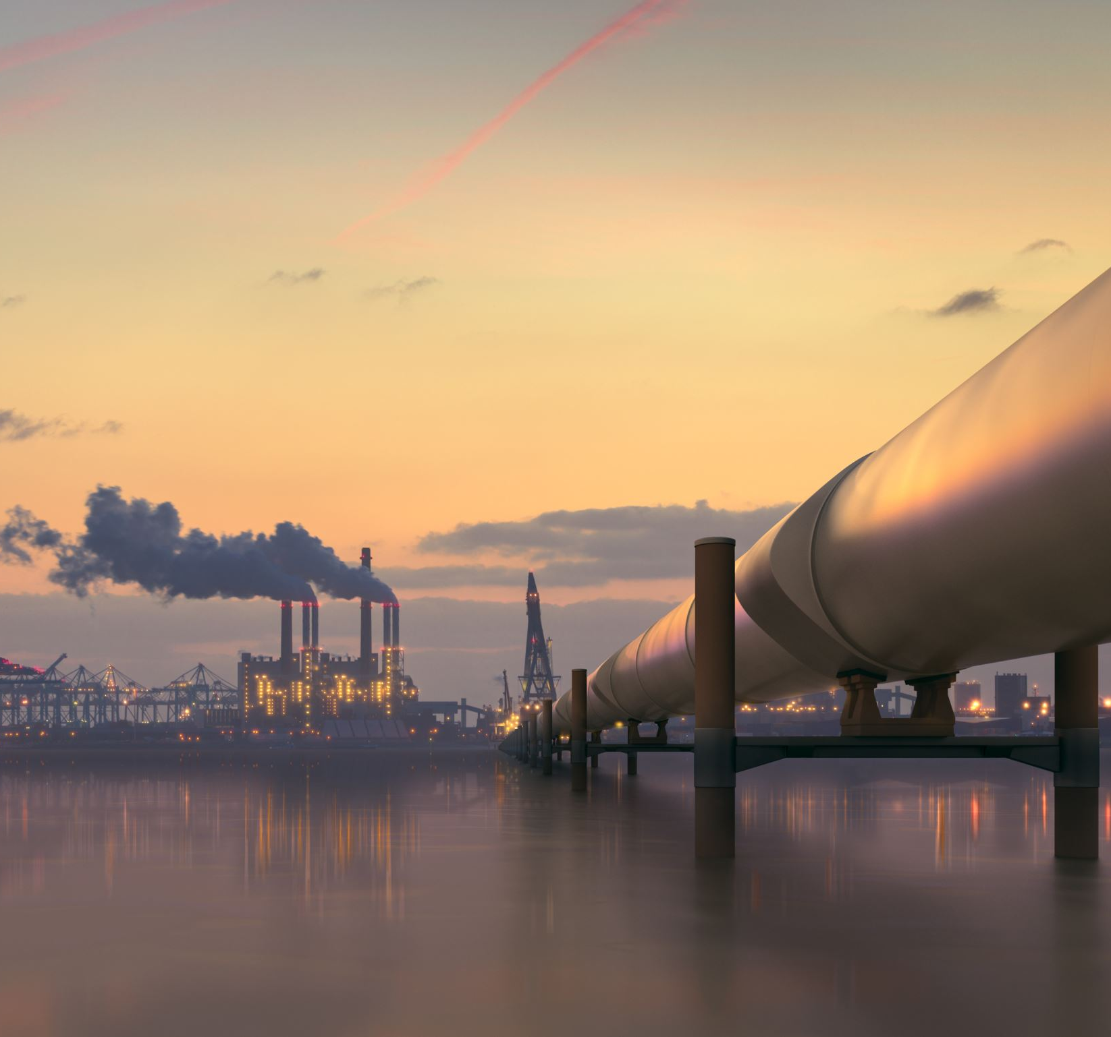
Business Objective
Combined-cycle power plants combine gas and steam turbines to generate electricity.
Exhaust from the gas turbine heats water in a heat recovery steam generator, creating steam to drive a steam turbine.
This project aims to model energy production as a function of:
Exhaust vacuum
Ambient temperature
Ambient pressure
Relative humidity
The resulting model will be used to optimize plant operations and increase efficiency.

Slide 3
Data Set
The dataset contains 9568 observations collected over six years from a combined cycle power plant operating at full load.
The variables include:
Temperature (degrees Celsius)
Exhaust vacuum (cm Hg)
Ambient pressure (millibar)
Relative humidity (%)
Energy production (MW)

Slide 4
Data Exploration and Cleaning
Initial data exploration using:
pandas library for data manipulation
matplotlib and seaborn for data visualization
Descriptive statistics like mean, median, standard deviation to understand data distribution.
Identification and handling of missing values (if any).
Checking for duplicates and removing them if necessary

Slide 5
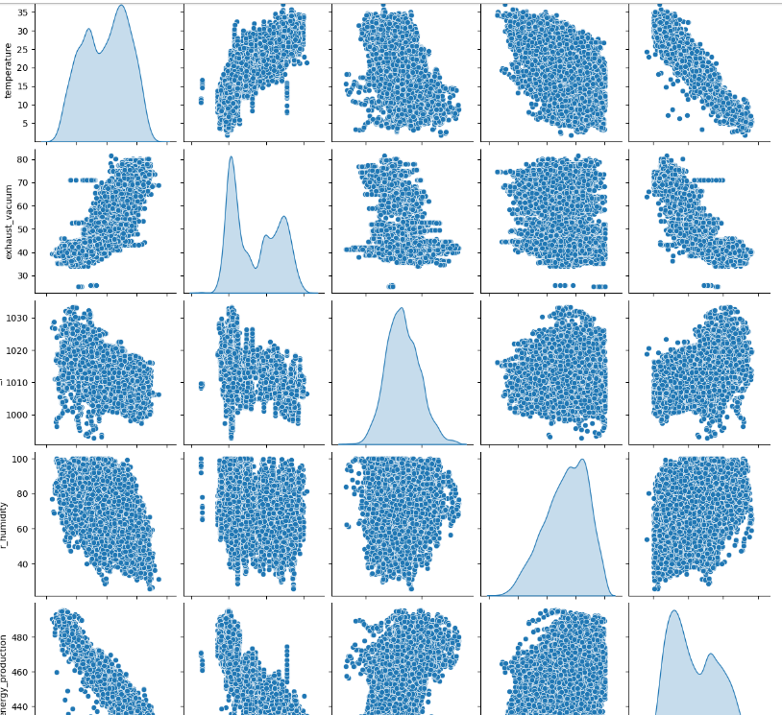
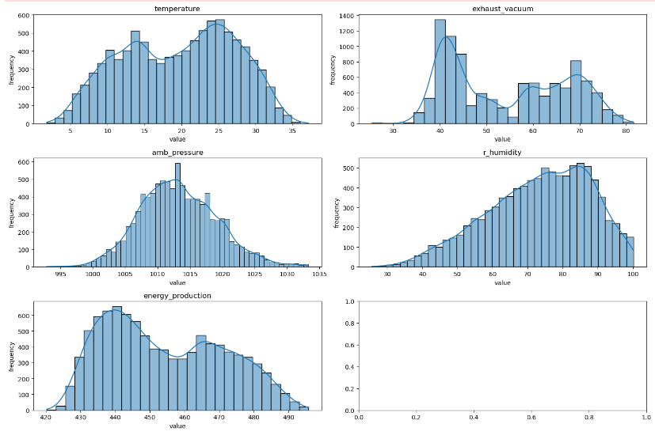
Data Visualization
Distribution Plots
Distribution of each variable visualized using histograms.
Helps identify potential skewness or outliers.

Slide 6

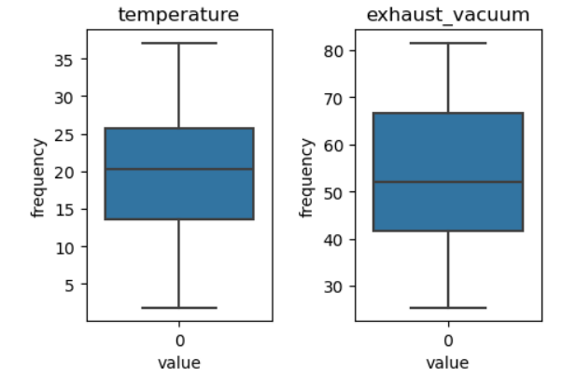
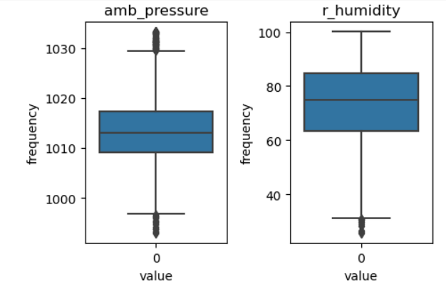
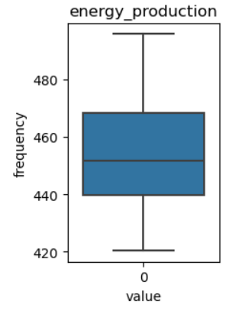
Data Visualization
Box Plots
Box plots created to visualize the distribution of each variable.
IQR (interquartile range) depicted along with median and outliers.

Slide 7
Feature Scaling and Model Performance
Feature scaling techniques like MinMaxScaler and StandardScaler were applied to numerical features in the dataset.
MinMaxScaler scales features to a range of 0 to 1.
StandardScaler scales features to have a mean of 0 and a standard deviation of 1.
Model performance was evaluated using Root Mean Squared Error (RMSE).

Slide 8
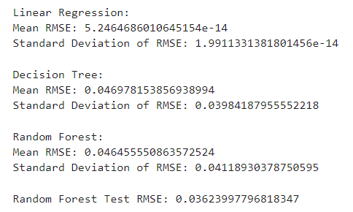
Model Performance Comparison
Three machine learning models were evaluated: Linear Regression, Decision Tree, and Random Forest.
Both before and after feature scaling, Random Forest consistently achieved the lowest RMSE, indicating its superiority in predicting energy production in this dataset.
The performance of Decision Tree also improved after scaling, suggesting its sensitivity to feature scales.
Linear Regression exhibited negligible RMSE, but it might not capture the non-linear relationships between features and energy production.
Feature scaling, particularly with Random Forest, yielded significant improvements in model performance.
The final Random Forest model can be used to predict energy production based on exhaust vacuum and ambient variables

Slide 9
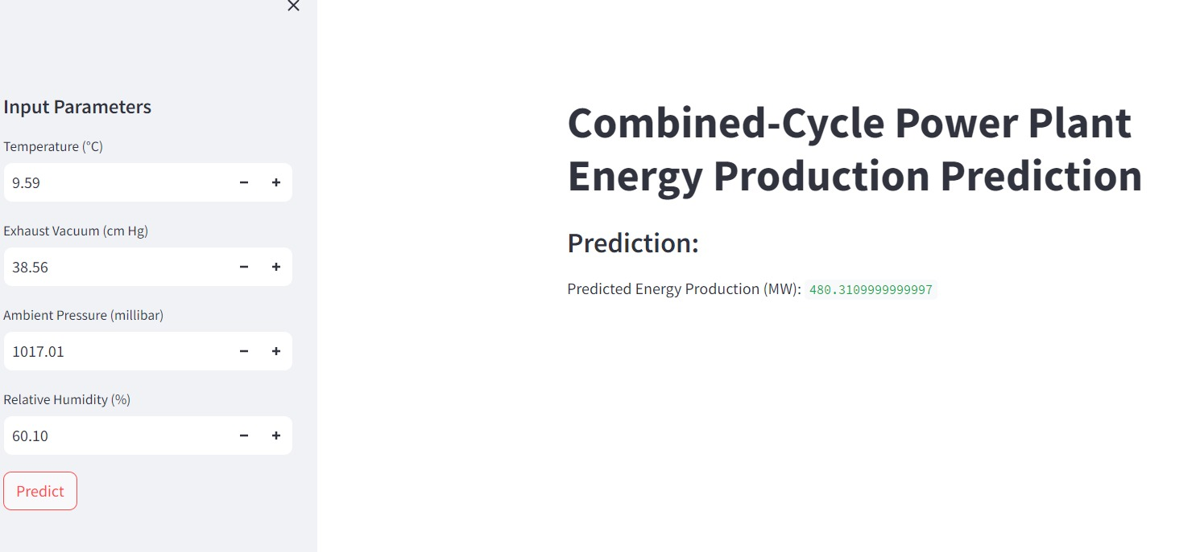
deployment

Slide 10

Thank you
Dr. Pritee Bharat Naikwade
Ms.Anupama Jena
Ms .ManasaMotikar
Ms. Vaishnavi Sangappanavar
Mr. Palthy Gopal Naik
Mr. Niraj Japagal

